Slide 1

Data Academy
Welcome
Introduction to the Data Academy

Slide 2

Communication
Communication during remote learning will include:
Class webinars (Teams)
Individual emails, messenger (Teams)
Calls Teams – as required
Email address: rahul@techtalent.academy
Telephone: Email or DM me via slack with your query I will schedule some time. This helps to manage calls.
Any questions regarding CVs contact ben@techtalent.acadmey for jobs and recruitment contact miranda@techtalent.academy
Any complaints or welfare issues contact georgina@techtalent.academy

Slide 3
Format of Course - Home Learning
There will be 1 class per week at 4.30pm every Wednesday. This will last between 1 and 2 hours.
Submission day is the day before your next class (Monday): includes practical work with an evaluation (not a pass or fail). Each week you will submit work through GitHub.
I work part-time and we will have two 1 hour support sessions on different days.
You can email and message out of hours and I will reply back to you as soon as I can.

Slide 4
Course Requirements
Attendance
70% of attendance is required to pass the course
If you can’t make it, then a notice must be given to the trainer for authorized absences
Home Learning Tasks
80% of each module’s Tasks must be completed
GitHub profile created and provided to your trainer
CV Skills Builder Workshop Attendance
LinkedIn Profile sent/Add Trainer
CV Provided after CV Session
30- and 90-Day employment update is required – Linked to your funding
Proof of employment or change in job role
Usernames must be your name on the Register

Slide 5



Software Requirements
In your welcome pack highlights what software is required for the course:
VS Code: https://code.visualstudio.com/download
GitHub
RStudio
MySQL Workbench
Google Colab - https://colab.research.google.com/

Slide 6
Course Overview
Week | Day | Topic
16th February 2022 | Wednesday 4.30pm to 6pm | Welcome, Respect
23rd February 2022 |  | Python 1 and Python 2
3rd March 2022 |  | Python 3 and NumPy
9th March 2022 |  | Pandas
16th March 2022 |  | Altair & Power BI
23rd March 2022 |  | Algorithms - Theory & SciKit
30th March 2022 |  | TensorFlow & AI Ethics
4th April 2022 |  | BCS Exam Prep
13th April 2022 |  | BCS Exam
20th April 2022 |  | Data Fundamentals theory and R1
27th April 2022 |  | R2 and GGPLOT Project
4th May 2022 |  | Big Data/Database Theory and SQL 1
11th May 2022 |  | SQL 2 and 3
18th May 2022 |  | Graduation

Slide 7
Assessments
BCS exam will be sat during one of your scheduled lessons. It is multiple choice of 18 questions and 60% is needed to pass.
If you fail and need to resit the exam, this can be arranged through TTA but you will need to pay the cost

Slide 8
IDE Integrated Development Environment
An integrated development environment (IDE) is a software application that provides comprehensive facilities to computer programmers for software development.
Pycharm
IDLE
Spyder
Jupyter Notebook/Lab
R Studio
Visual Studio (VS) – this is what you will be using
Repl.it (Web-Based)
Notes:
It’s where we write our code
PyCharm – free. Limited to what you can do but has more function and libraries above 2.
IDLE – 2 windows, write in one and test in the other.
Anaconda – Suite – good R. Jupyter (web) and Spyder.
Replit – web based. Not good because you cannot save files, or use complex libraries and function.
Go through what an IDE.

Slide 9
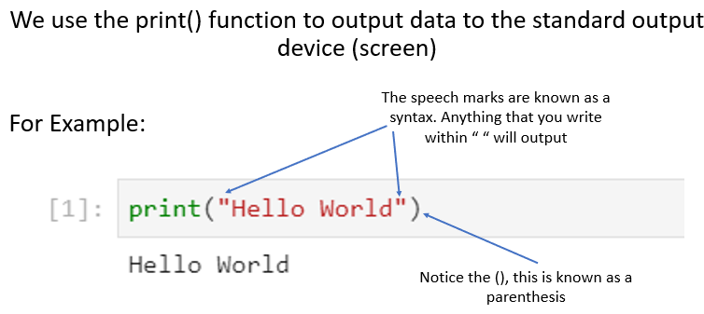
Using the print() function
Notes:
Just like when we send a document to print, by using the print() function we are commanding the computer to print something which gives us an output.
You will discover that in the coding world there are a lot of traditions. One of those traditions is that your first piece of code writing is something called “Hello World”
Im going to give you an example of how that is written inside a few different IDE’s
Show print(“Hello World”) in all environments.

Slide 10
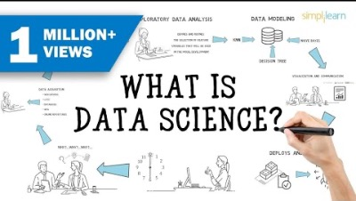
What to Expect

Slide 11
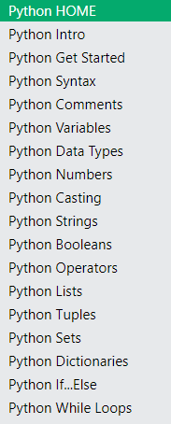
Practice Code
Once you have VSCode installed you can have a practice writing code before our next session
https://www.w3schools.com/python/default.asp

